Slide 1
MTP Interim Progress Report:
Fluid Flow Simulation using Deep learning
Mentor - Dr Gaurav Bhutani
Piyush Bafna B17020
Shashi Kumar Fagna B17141
Toshendra Rustagi B17147

Slide 2
Overview
Introduction
Objective and Scope of Work
Experiments carried out
Results and conclusion
Progress till date
Milestones
Future aspect

Slide 3
Introduction
Fluid Flow Simulation using Graph Neural Network
Fluid Flow Simulation is quite useful for modelling various situations.
The solving of the Navier Stokes equation is computationally expensive and by using deep learning techniques we can generate faster simulations governed by the Navier Stokes equation.
The efficiency of such a Graph Neural Network can help to create high-quality simulation on portable, less powerful PCs in gaming etc. as compared to High-Performance Cluster required for current techniques.

Slide 4
Objective and Scope of Work
Objectives
Creating DL models for Fluid Simulation.
Generalize with respect to obstacles
Create a generic model for different fluids
Generalize with respect to Scalability
Scope of Work
Simulation of water after dam break.
Avalanche Simulation
Sloshing of water in water tanker truck

Slide 5
Our Model: GNS Framework
Graph Network-based simulator framework is single deep learning architecture. This framework can be used to learn to simulate complex physics problems. It is found that GNS can learn to accurately simulate a wide range of physical systems in which fluids, rigid solids, and deformable materials interact with one another.
The framework imposes strong inductive biases, where rich physical states are represented by graphs of interacting particles, and complex dynamics are approximated by learned message-passing among nodes.

Slide 6
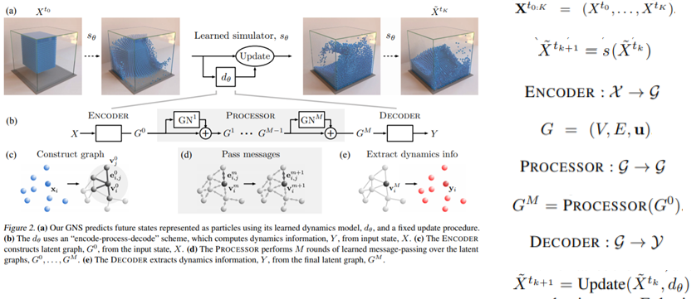
GNS Framework: Working

Slide 7
Experiments Carried Out
Experiment 1
Creating Specific Models for Sand, Goop and Water Ramps.
Experiment 2
Creating a Generic Model for materials that have similar properties.

Slide 8
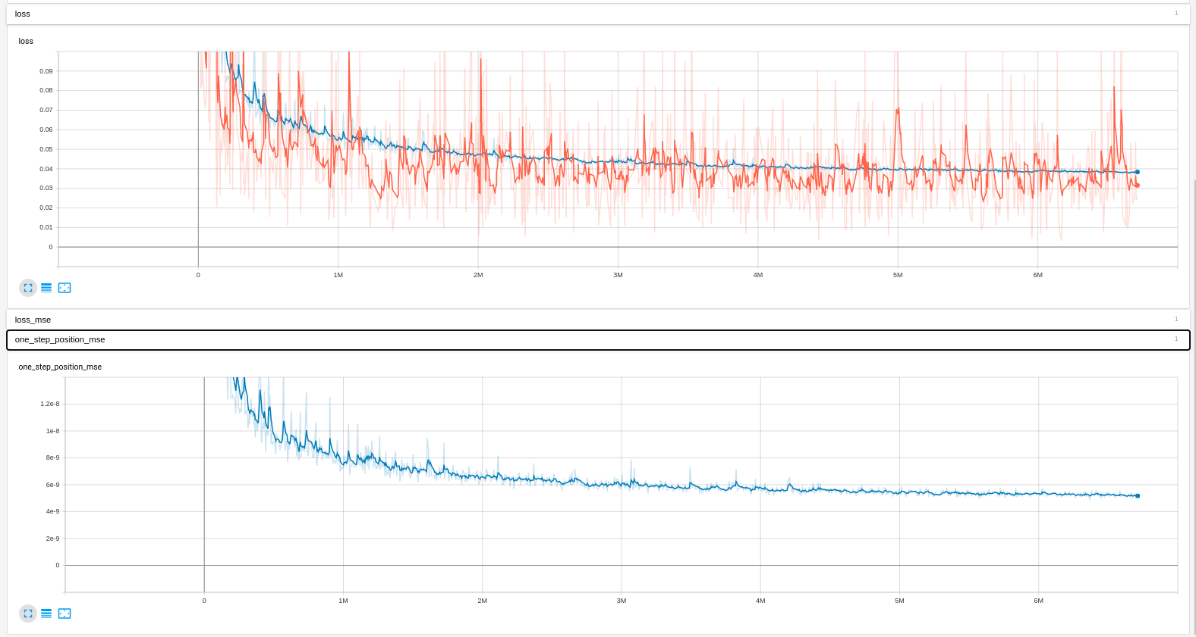
Experiment 1: Creating Specific Models for Sand, Goop and Water Ramps.
Water Ramps :
No of Training samples- 1000
No of Validation samples - 100
1.1 Water-Ramps
Learnings from the graph
The model was trained for 6M training steps.
We observe a gradual decrease in validation loss over the training process.
The best validation loss is 5✕10^-9 (one step MSE loss)
Training loss vs training step
Validation loss vs training step

Slide 9
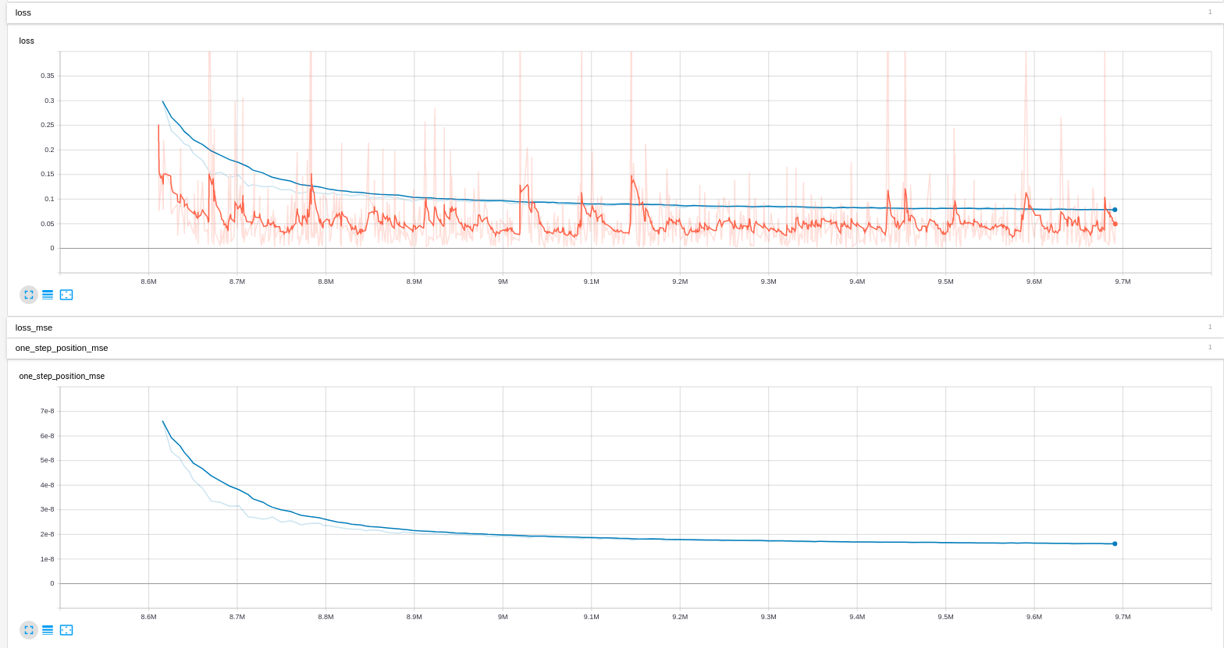
Experiment 1: Creating Specific Models for Sand, Goop and Water Ramps.
Sand :
No of Training samples- 1000
No of Validation samples - 30
1.2 Sand
Learnings from the graph
The model was trained for 3M training steps.
We observe that validation loss almost remains constant after the first 500k steps.
The best validation loss is 7.09✕10^-9 (one step MSE loss)
Training loss vs training step
Validation loss vs training step

Slide 10
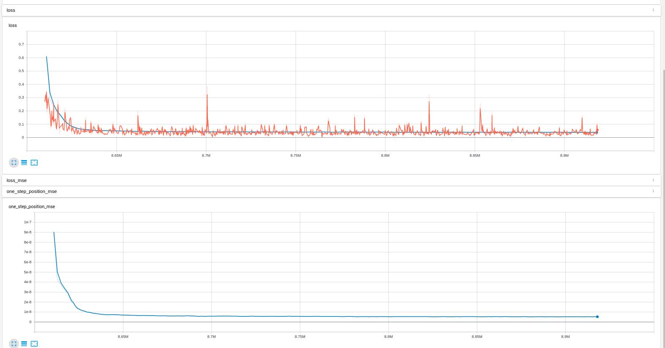
Experiment 1: Creating Specific Models for Sand, Goop and Water Ramps.
1.3 Goop
Goop :
No of Training samples- 1000
No of Validation samples - 30
Learnings from the graph
The model was trained for 3M training steps.
We observe that validation loss remains constant after the first 100k steps.
The best validation loss is 3✕10^-9(one step MSE loss)
Training loss vs training step
Validation loss vs training step

Slide 11
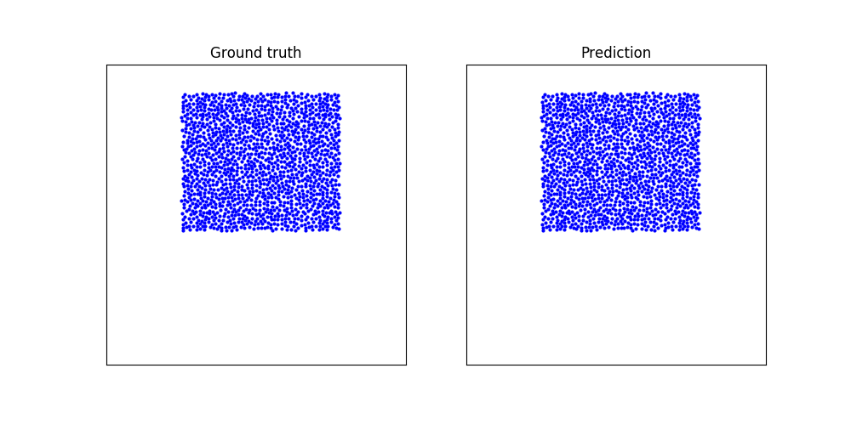
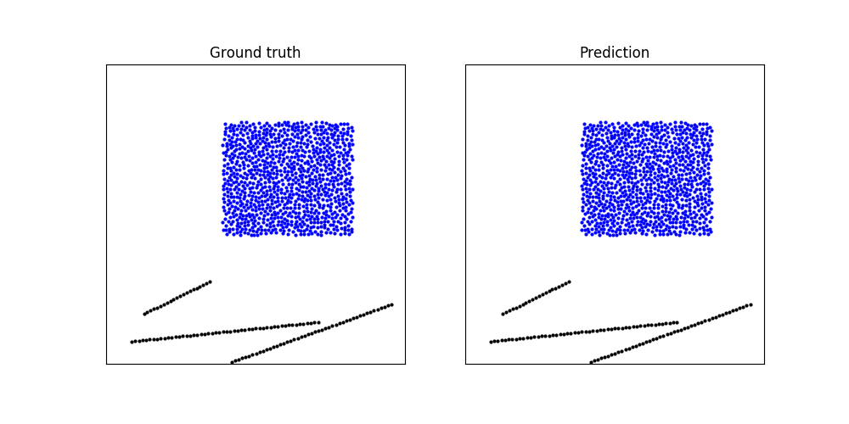
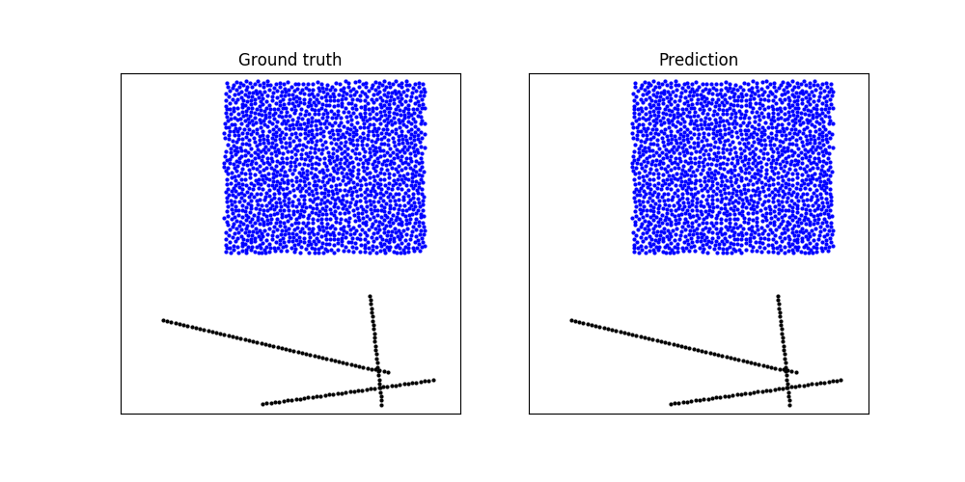
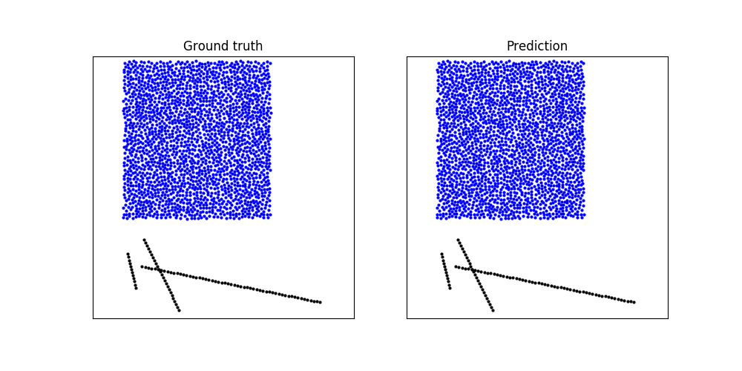
Outputs of Water-Ramps Dataset

Slide 12
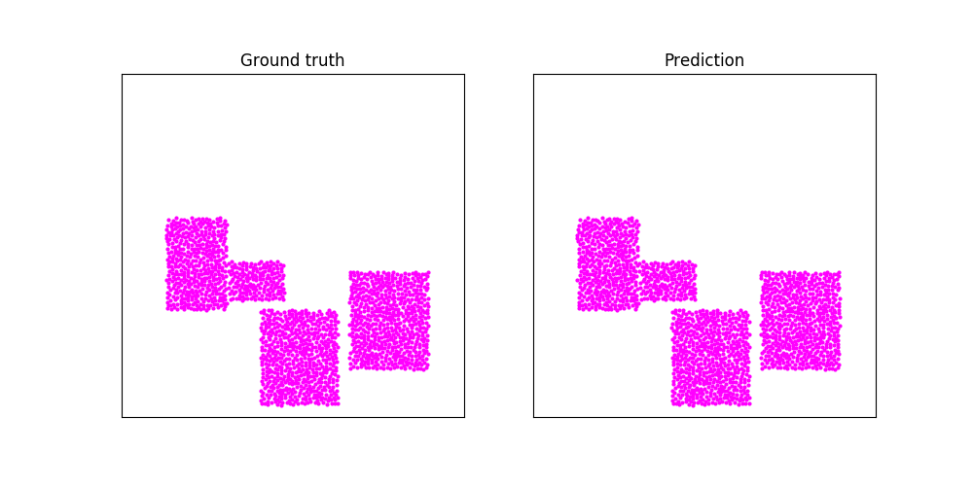
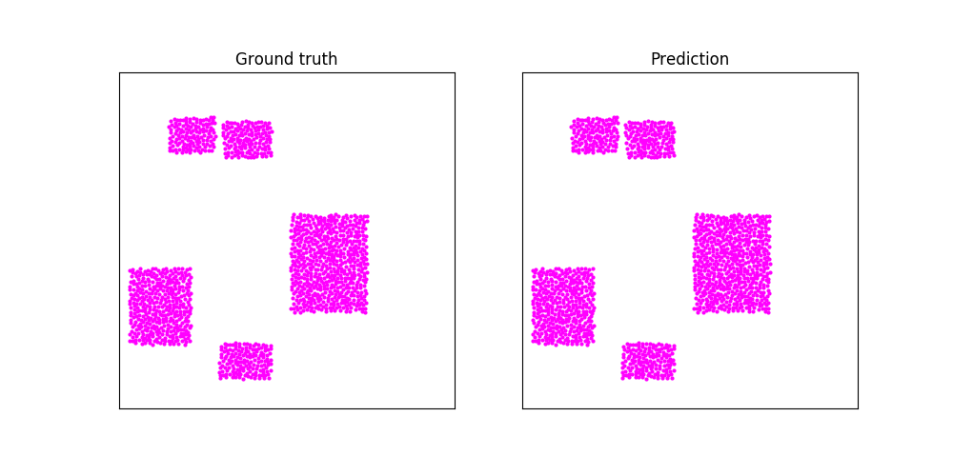
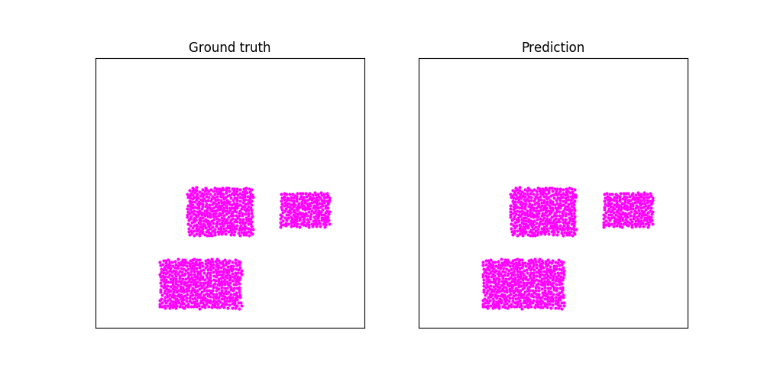
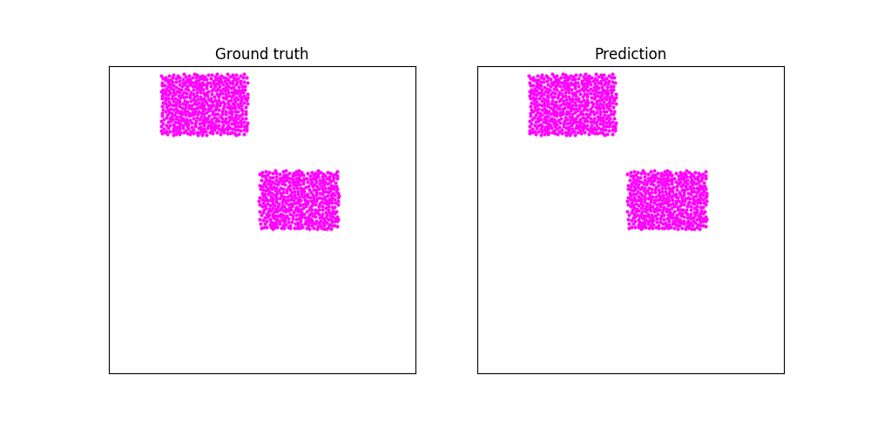
Outputs of Goop

Slide 13
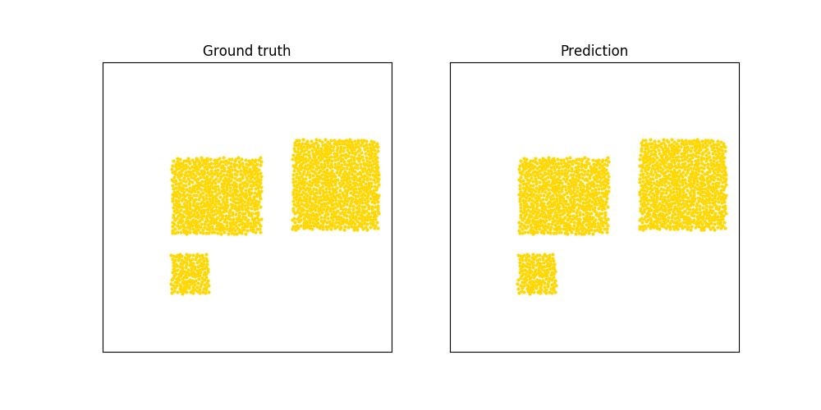
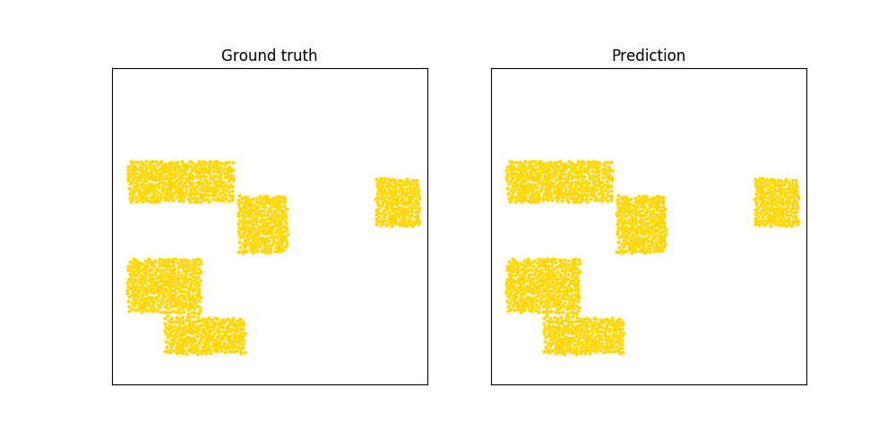
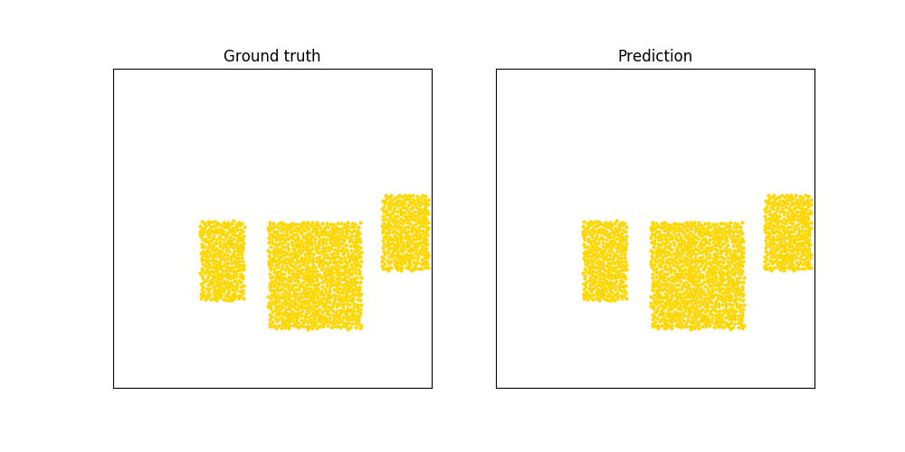
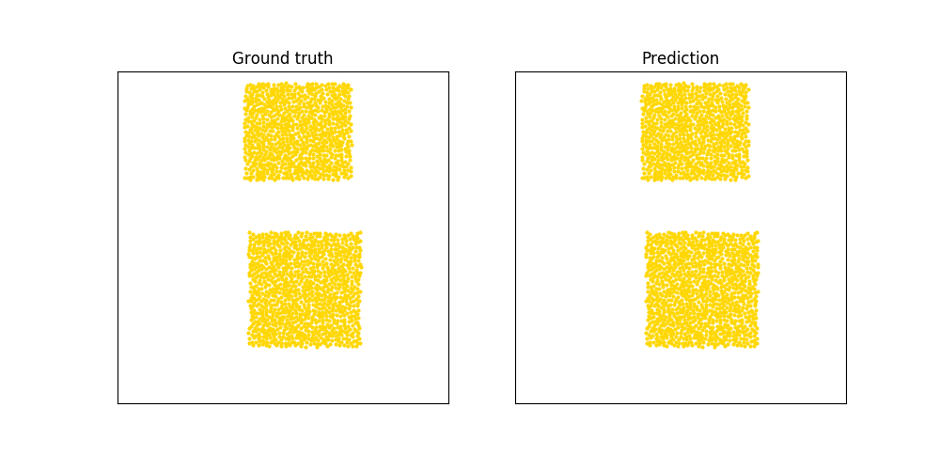
Outputs of Sand

Slide 14
Observation Tables
Material | N(Nodes) | K(Edges) | Training Steps
WaterRamps (MPM (2D)) | 2.3k | 600 | 8M
Sand (MPM (2D)) | 2k | 320 | 3M
Goop (MPM (2D)) | 1.9k | 400 | 3M
Node : Number of particles in a data sample.
Edge : Contains dynamics information between two particles e.g., exchanging energy or momentum.
Graph Network constitutes of nodes and edges.
Table 1 ()
Material | Given one-step Test loss (10^-9) | Our one-step Test loss (10^-9) | Given Rollout Test loss (10^-3) | Our Rollout Test loss (10^-3)
WaterRamps | 4.91 | 6.00 | 3.34 | 5.64
Sand | 6.23 | 9.10 | 2.37 | 4.6
Goop | 2.91 | 5.00 | 1.89 | 2.7
Table 2 (Comparison of losses)

Slide 15
Conclusions
In WaterRamp, we trained our model over ramps of different length and slopes. Each training data in the dataset contains different kinds of ramps.
If we train a specific model over the weights of a pretrained model over another dataset, we observe that the convergence occurred at very less train steps as compared to training it from scratch.
When we train models over 200k training steps, prediction results work but were not accurate. The accuracy can be increased by increasing the number of training steps upto 3 million steps.
From table 1, we understood that the training time of the model depends on the number of Nodes and Edges in the graph model of that particular dataset.
We were able to achieve values close to the values given in the research paper.

Slide 16
Experiment 2: Creating a Generic Model for materials that have similar properties.
Material | N(Nodes) | K(Edges)
WaterRamps (MPM (2D)) | 2.3k | 600
Sand (MPM (2D)) | 2k | 320
Goop (MPM (2D)) | 1.9k | 400

Slide 17
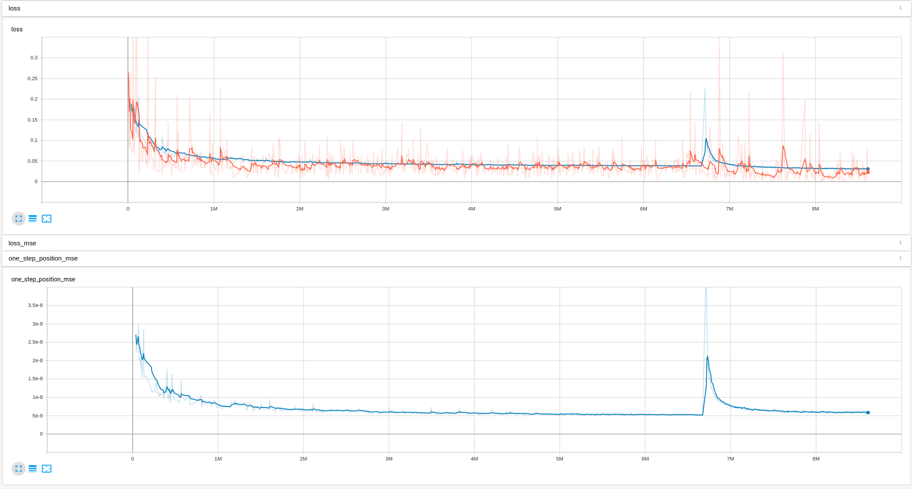
Generic Model
Learnings from the graph.
High loss is observed at the start of the training process. The loss gradually decreases till the 6M training step.
A second peak is observed after 6M, that is at the start of fine-tuning on Sand Dataset.

Slide 18
Generic Model vs Model Trained on Single Material
Performance of model when trained only on Goop Dataset.
Material Type | Our one-step loss (10^-9)
Goop | 7.23
Performance of model after Fine-tuning to Sand Dataset
Material Type | Our one-step loss (10^-9)
Sand | 3.00
Goop | ∞ w.r.t other loss

Slide 19
Output of Experiment 2
After Fine-tuning
(trained first on Goop and then on sand )
Before Fine-tuning (trained only on Goop)

Slide 20
Observations
Model when trained for two dataset forgets the initial dataset learnings.
The model behaves randomly on the initially trained dataset.
No improvements were found even after changing the learning rate, training steps, or training dataset.
Comment
The two datasets cannot be combined to form a single training set as both the particles have different metadata.json files. Hence, they are trained sequentially instead of training simultaneously.

Slide 21
Conclusion
Conclusion
To generalize, the model was trained over one type of dataset(X) for 70% of the training time and remaining time on another dataset(Y). This makes the model behave more like that it is trained on a dataset(Y) than on both X and Y.
Possible Reason for Failure
There is no uniformity in the given dataset, the number of particles, timesteps per frame, time interval. This may be considered as the cause for the above behaviour of the model.
Domain | Max # particles | Trajectory Length | # Trajectories (train/val/test) | ∆t [ms]
SAND | 2k | 320 | 1000/30/30 | 1.5
GOOP | 1.9k | 600 | 1000/30/30 | 2.5

Slide 22
Studying Research Papers
Creating Specific Models
Creating a Generic Model
Step 1
Step 2
Step 3
Step 4
Step 5
Preparing code and setting up HPC
Generating Dataset using MPM

Slide 23
Milestones
Milestone 1 DONE
Trained one model each for different kind of fluids.
Milestone 2 DONE
Training a model to be robust to obstacles.
Milestone 3 ONGOING
Trying to generalize the model so that one model can be used for different kind of fluids.
Milestone 4 YET TO START
Trying to achieve scalability so that input with different number of particles can be used.

Slide 24
Next Steps
To generalize our model, we plan to carry out multiple experiments where we use MPM to generate data that is uniform in terms of number of particles, trajectory length and same time interval between frames, then train the model on the generated data and analyse the results.

Slide 25
Future Aspects of the Project
We find the project to be propitious. This project can help us save millions of life that are lost during Avalanche and flood.
Recently, on 12th Feb, uttarakhand witnessed a disastrous flood. With help of our model, we can simulate the flood flow and alert the people in the danger-zone well before the flood reaches to them.

Slide 26
Thank You

